Slide 1
Optimizing BLANT’s community finder
scripts/blant-clusters.sh
Notes:
Everything today is about one script: blant-clusters.sh, the stage after BLANT sampling that turns graphlet counts into communities. The punchline up front: same clusters byte for byte, much faster, and the gap grows with network size.

Slide 2
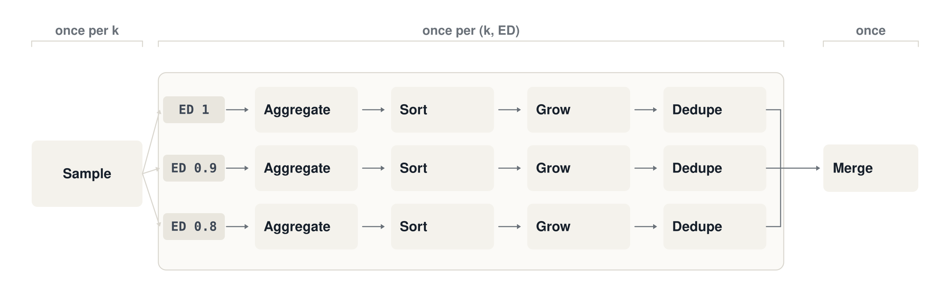
The pipeline
Notes:
Quick refresher, since everyone here knows BLANT. Sampling runs once per k; aggregate, sort, grow and dedupe run once per k and ED pair, nine times for a typical run; merge runs once at the end. Grow takes most CPU; dedupe and merge compare clusters pairwise, which is what blows up on large networks.

Slide 3
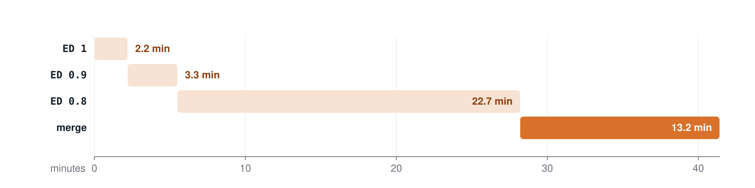
Master on com-Amazon
master, k = 4, one -p0.9L BLANT sample (7.5 h to produce); EDs run one after another; times from its intermediate files
Ran on Mac Mini M1
Notes:
Measured, not estimated: the timestamps of master's per-ED output files. Low density is where clusters multiply, and every cluster gets compared with every earlier one twice: in dedupe and in the final merge. That is the quadratic part the branch removes.

Slide 4
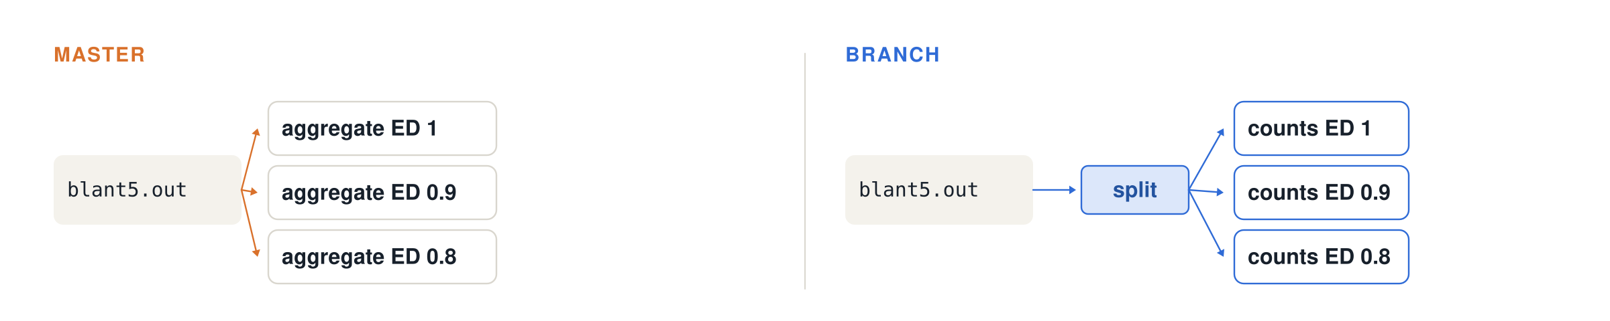
One read per sample file, streamed to every ED
master re-reads and re-aggregates once per ED
After optimization, reads once and sort with LC_ALL=C
Notes:
Master reads and aggregates each BLANT file once per edge density. The branch reads it once and writes each line to the counts file of every density it qualifies for. Concurrency is deliberately unchanged from master: the k's run in parallel, the densities one after another. Running every pair at once crashed the machine; more on that later.

Slide 5
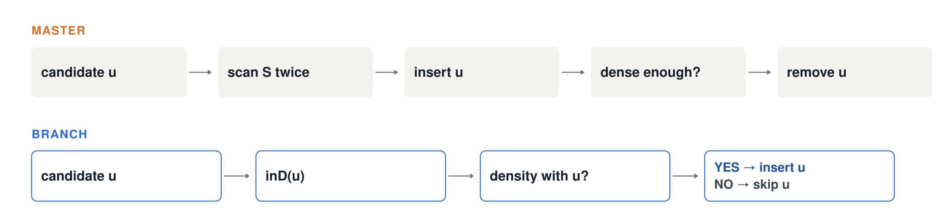
Cluster growth: most candidates are rejected, so reject cheaply
Notes:
Master pays two full scans of the cluster plus an insert and a delete for every rejected candidate, and most candidates are rejected. The branch computes edge count and weight in one pass over whichever list is shorter, tests density as if u were added, and only touches S on success.

Slide 6
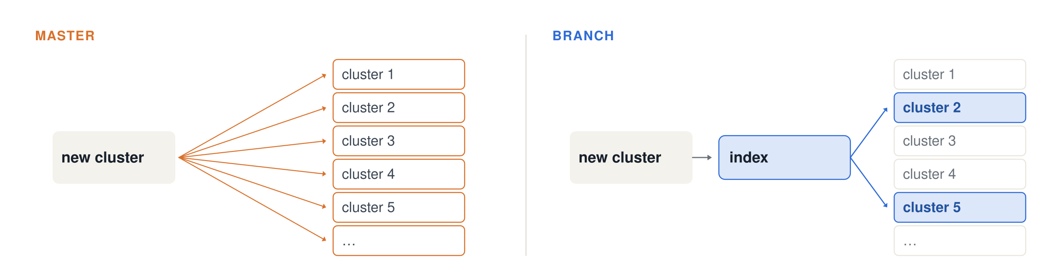
Dedupe and merge: check only clusters that share a node
Exact duplicates: one hash lookup of the sorted members.
Notes:
Only clusters that share at least one node with the new cluster can overlap it by more than half, so the index finds every cluster that could reject it, and nothing else. Exact duplicates are a hash lookup on the sorted member list. Both are textbook fixes, and they only matter at scale: com-Amazon sent 41 thousand clusters into the final merge.

Slide 7
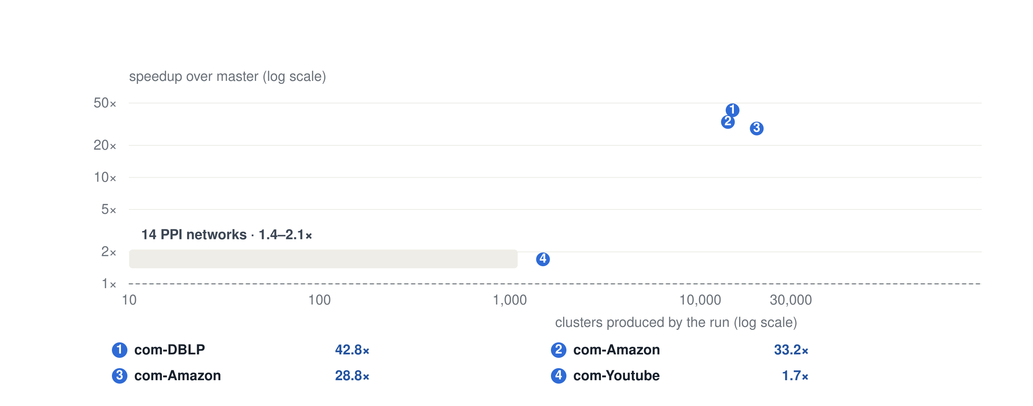
Speedup more when the number of clusters grows
Speedup over master, same BLANT samples and seed. Gray: lab PPI networks, k = 4–6. Blue: SNAP graphs, k = 5.
Notes:
The single most useful picture. On our PPI networks we get 1.4 to 2.1x. The big wins line up with cluster count: com-DBLP and com-Amazon each produce about 14 thousand clusters and get 33 to 43x, because master's dedupe and merge are quadratic in the cluster count. com-Youtube is the biggest graph, but it produces only 1,500 clusters, so it gets 1.7x, which comes from cluster growth alone.

Slide 8
Speedup more when the number of clusters grows
com-DBLP
master 41.8 min
14,796 clusters · k = 5
branch 58.5 s · 42.8×
com-Amazon
master 34.5 min
13,988 clusters · k = 5
branch 62.3 s · 33.2×
com-Amazon
master 64.1 min
19,821 clusters · k = 4–6
branch 2.2 min · 28.8×
com-Youtube
master 60.7 s
1,494 clusters · k = 5
branch 35.9 s · 1.7×
Notes:
Each pair is drawn to its own scale: the orange bar is master's time, the blue bar the branch's, so the blue length is one over the speedup. The three graphs with thousands of clusters drop from half an hour or more to about a minute. com-Youtube is the largest graph but produces few clusters, so there is little to merge and the gain is 1.7x. Same BLANT samples, one seed, byte-identical output.

